Slide 1

Home buying guide application
Project Dashboard
Sep 14, 2023
Tarun Konagalla, Trace Miller, Venkatesh Karadbhajne Manas Bhojwani(Project Manager):
WOW (09/07, 09/11, 09/12, 09/13 / 3 pm CST, Zoom Meeting, Online (Zoom))
Notes:
September 2010
1

Slide 2
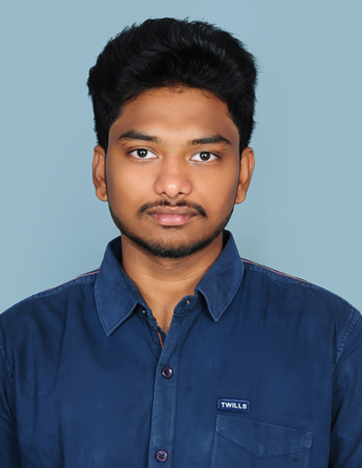

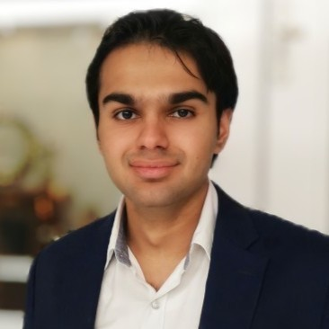

Team Profile Page
Tarun Konagalla
Dallas, TX
Graduate Student
I play cricket well, also played some football tournaments
back in my country
Trace Miller
Graduate Student
Plays competitive golf and hit a hole in one in a tournament
Venkatesh Karadbhajne
Graduate Student
I like to go for a hike, long walks. Big on music and coffee.
Manas Bhojwani
Dallas, TX
Aspiring Computer Scientist
Graduate Student
I love to keep myself active by playing cricket and going to the gym.
Notes:
Individual Picture of each member
Hometown (city, state)
Primary focus area or desired focus area
Current internship position or job position (company is not needed)
One interesting fun fact about the person

Slide 3
Project Idea Brainstorming
Digital Marketing with E-Commerce: The mobile app/web application to allow small vendors to onboard and market/sell their products with different delivery models of their own.
House buying guide web application to enable buyers with different budges to provide information (interest rates etc.) and associate it with good real estate deals from different companies.

Slide 4
Statement of Work Summary
Project Summary – This is a web application, and it also has a mobile app (iOS and Android). It provides detailed house buying details (guide) to home buyers.
Why did the team pick this solution?
In today's market, in the US, rents are on the increasing trend. There are first time home buyers who need specific details about the home mortgage (loan and interest rates), paperwork,
house prices etc. This will help them to get the information and to connect them with real estate companies and direct sellers (home-owners).
What are the components and key features of the project idea?
Components:
Web application, Mobile App
Gather and Identify data using ML
Search Queries

Slide 5
Statement of Work Summary
What are the components and key features of the project idea? (continued …)
Features:
Property search capability based on different filters like location, price and value.
Connecting users to legal team and , real estate companies, direct sellers etc.
Revenue : User subscription model and fees for listing the property
and commission for the closed deals.

Slide 6
Cost / Price / Rationale
Cost Overview
Teams: Architecture team, Front End Developers, Back End Developers, QA, Deployment, Project Management
Architecture team: The team has 10 people with two lead architects and 8 other architects.
Front End Team: The team has 15 front end developers (including 5 lead developers).
Back End Team: The team has 25
back-end developers (including 5 lead developers).
QA: The team has 15 QA members (including 5 QA leads).
Deployment: The DevOps team has 15 members (including 5 DevOps leads).
Project Management: The project management team has one project manager and 10 associates.

Slide 7
Cost / Price / Rationale
Cost Overview (Per hour rate calculation)
Architecture team: Lead - $200, team member - $125
Front End Team: Lead - $150, team member - $100
Back End Team: Lead - $150, team member - $100
QA: Lead - $150, team member - $100
Deployment: Lead - $150, team member - $100
Project Management: Project Manager - $400, associate: $200
Total (One Day for 6 hrs.): $70800
3 month's Estimate (total cost: $849600
Margin of 25%: $212400
Total Price to Customer –$1,062,000

Slide 8
Stakeholder Table
Stakeholder | Role | Team | Value
Lisa Blanche | Director of IT | Customer IT | Provides leadership to customer IT team for project engagement and delivery.
James Smith | Director of Development | Client Delivery Team | Provides leadership to development team on technology, resource, and project engagement
Trace Miller | Architecture Head | Architecture Team | Involved in project software design and architecture.
Tarun Konagalla | QA Head | QA team | Involved in creating test plan and test deliverables.
Venkatesh Karadbhajne | DevOps Head | DevOps team | Involved in deployment of the software system in different environments.
Manas Bhojwani | Project Manager | Project Management Offices | Works with different stakeholders and management of the overall project.
Mike Brodale | Client (Point of Contact) | Customer Management | Client product team which provides project requirements and feedback.
Smith Rich | Sales Head | Sales team | Involved in finalizing the project deal.

